Slide 1

Improving Integration between Bahmni ERM and Odoo Using Messaging-Oriented Middleware
By: Moeketsi John Ntaole
Lehlohonolo Matsikane Moeling
201902695
201902032
Supervisor: Mr. Lebajoa Mphatsi

Slide 2
Table of contents
01
04
02
05
03
06
Overview
Solutions
Background
Methodology
Scope
Conclusion

Slide 3

01
Overview
Project aims to revolutionize the data synchronization process between Bahmni ERM and Odoo by transitioning from the current Atom-feed-based Change Data Capture (CDC) approach to a more robust Messaging-Oriented Middleware (MOM) solution

Slide 4

02
Background

Slide 5



Open source HIS
Components
Brahmin is an open source and free to use Hospital Information system (HIS)
One of the 23 digital public goods recognized projects
Implemented in more than 500 hospital across 50 courtiers
Lesotho implementation in work
Bahmni combines three open source products
OpenMRS Distribution: For electronic medical recording
OpenERP: For Hospital Operations
OpenELIS: Lab information management system
Feature List

Slide 6

Bahmni – Focuses on all aspects of patient care

Slide 7
Integration and Interoperability
How does Brahmi provide integration over all services?
Bahmni is modular
New components in and old ones removed
Bahmni can be enhanced at multiple levels
Custom distribution of OpenMRS
Adding new definitions for different services
Adding new components based on standards
Atom Feeds over HTTP
All Bahmni components communicate with each other using Atom feeds
Each component publishes a log of relevant events happening
Other components listen to this feed using libraries
Only authorized clients can listen to feeds
Rich data interface over standard API and push and pull data updates directly

Slide 8
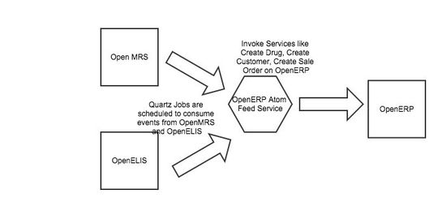
Atom-Feed Service

Slide 9

03
Problem And Scope

Slide 10
Problem
Slow Data Synchronization
Atom feed method does not cater for real time syncronization
Error Handling
Atom feed does not have any error handling, no acknowledgement of whether data was received or not and does no correction
Reliability
Not all Data requests are successfully reach destination.

Slide 11





Scope Statement
Scope statement
The project aims to enhance the existing CDC (Change Data Capture) integration within the Bahmni ERM (Electronic Medical Record) and Odoo systems by transitioning from the current Atom-feed-based mechanism to a more robust Messaging-Oriented Middleware (MOM) solution. The objective is to improve real-time data synchronization, error handling, and security measures.

Slide 12
Objectives
Assesment
MOM Selection
Create Data consumer modules
Conduct thorough assessment of current Atom-Feed-based CDC integration to identify strengths, weaknesses and areas of improvement
Select appropriate MOM considering performance, reliability , and compatibility with Bahmni ERM and Odoo
Create a data consumer module in Odoo that will consume data events and implement data transformation logic
MOM integration
Create data producer modules
Data migration strategy
Develop a data producer within Bahmni ERM to capture data events and publish them to MOM
Implement selected MOM based solution ensuring realtime syncronization, error handling and data security.
Create detailed strategy to outline the process of transitioning from Atom fee to chosen MOM solution

Slide 13
Requirements
Functional Requirements
Non-Fuctional Requirements
Data producer on Bahmni
Data consumer on Odoo
Real-time Synchronization
Error handling and fault tolerance
MOM system
Reliability
Scalability
fault tolerant
Compatibility
resource efficiency
throughput

Slide 14
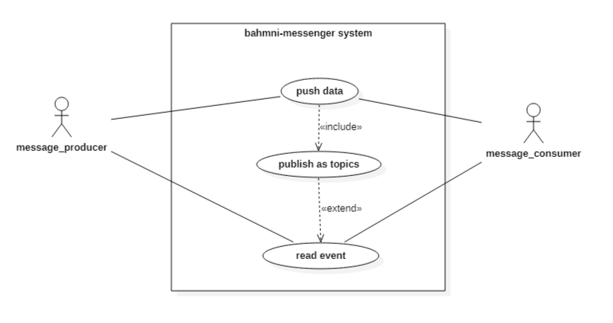
Use Case Diagram

Slide 15

Conceptual System design

Slide 16

04
Methodology

Slide 17

Iterative Incremental development (IID) Model
Focus on dividing the project into parts such as
Data consumer on Odoo
Data producer on OpenMRS
Message middleware
Iterations repeated until the product reaches a desired level of functionality such messages reliably.
Enhancements and other features added each iteration such as scalability to other services.

Slide 18

05
Deliverables and Time Frame

Slide 19
Project activities
Activity | Start date | End date
Initiation | 01/11/2023 | 16/11/2023
Planning | 16/11/2023 | 05/01/2024
Implementation | 06/01/2024 | 25/04/2024
Integration and testing | 20/03/2024 | 14/05/2024
Documentation | 14/05/2024 | 25/05/2024
Closing | 25/05/2024 | 30/05/2023

Slide 20
Project roadmap
Initiative | Objective | Nov | Dec | Jan | Feb | Mar | Apr | May | Jun
Initiation | Kick-off the project
Planning | Development plan, identify suitable MOM and Bahmni analysis
Implementation | Data produce, consumer and MOM development
Integration and testing | Combining all components and making sure they work in unison
Documentation | Project Write up and final project report write up
Closing | Project closing party

Slide 21

Project Deliverables
Data Producer Module
Message-oriented Middleware
Data Consumer Module
A module in Bahmni ERM to detect relevant data changes in Bahmni database and publish them to the Message Middleware.
Middleware that connects the data producer with the data consumer.
Software for seamless exchange of data between consumer and receiver
Handle message topics and queues
Simulate data synchronization
Odoo component that receives MOM messages and consume data events.
Implement data updates in response to receive messages.

Slide 22
06
Conclusion
In conclusion, our project's shift to Messaging-Oriented Middleware (MOM) technology addresses synchronization challenges, ensuring real-time data exchange with enhanced security and error handling. This transformation is a strategic move towards a more responsive and interconnected healthcare-ERP landscape.

Slide 23
References
https://bahmni.atlassian.net/wiki/spaces/BAH/pages/3506200/Atom+Feed+Based+Synchronization+in+Bahmni
https://bahmni.atlassian.net/wiki/spaces/BAH/pages/61997323/Bahmni+Online+Demo
https://www.bahmni.org/contact-us
https://docs.google.com/presentation/d/16Wud_m4Yzq6mm3IH2Q6H4jSHEtjNiU1WA2HVHnslPvQ/htmlpresent
https://eregister.github.io/docs/ereg/eRegister-092-Release-Notes

Slide 24
Thanks You!
Do you have any questions?
moeketsintaole@gmail.com
+266 57742381
+266 58839504
Thank you for your attention

